Slide 1
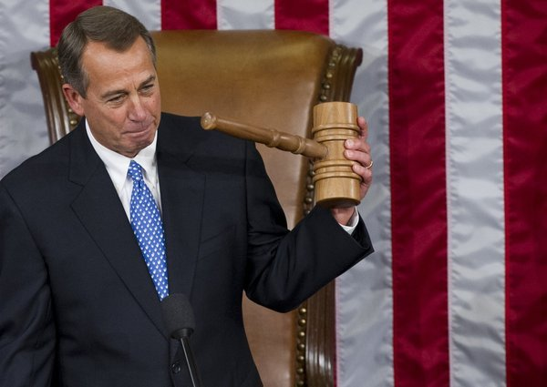
Congressional Leadership

Slide 2
Senate | House
President of the Senate President Pro Tempore Majority Leader Majority Whip Minority Leader Minority Whip | Speaker of the House Majority Leader Majority Whip Minority Leader Minority Whip

Slide 3
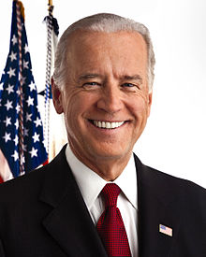
President of the Senate
Vice President of the US
Presides over the senate
Can only vote to break a tie
Joe Biden

Slide 4
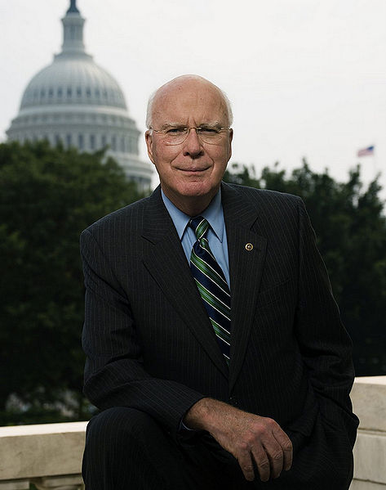
President Pro Tempore of the Senate
Presides over the senate in the absence of the VP
“Pro tempore” Latin for “for the time being”
Appointed by the VP; usually the most senior senator of the majority party
Patrick Leahy (democrat)

Slide 5
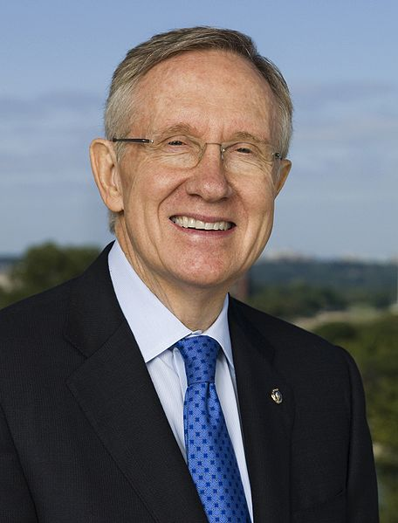
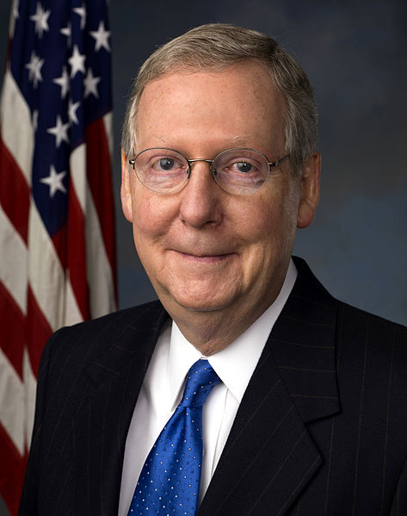
Senate Majority & Minority Leaders
Political spokesperson of the majority/minority party
Majority Leader plans legislative program
Majority Leader – Harry Reid (D)
Minority Leader – Mitch McConnell (R)

Slide 6
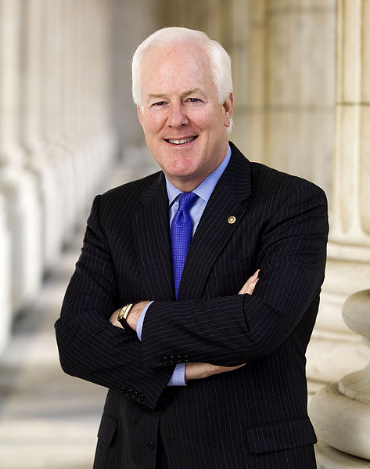
Senate Majority & Minority Whips
Assistant to the Majority/Minority Leaders
Enforcer who “Whips” their party members into shape
Ensures senators are present to debate/vote and that they vote with their party
Majority Whip – Dick Durbin (D)
Minority Whip – John Cornyn (R)

Slide 7
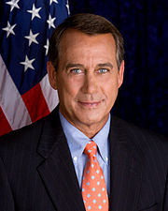
Speaker of the House of Representatives
Presides over the House and joint sessions of Congress
Calls on members who wish to speak
Decides outcome of voice votes
Refers bills to committees
Can vote and take part in debate
John Boehner (republican)

Slide 8
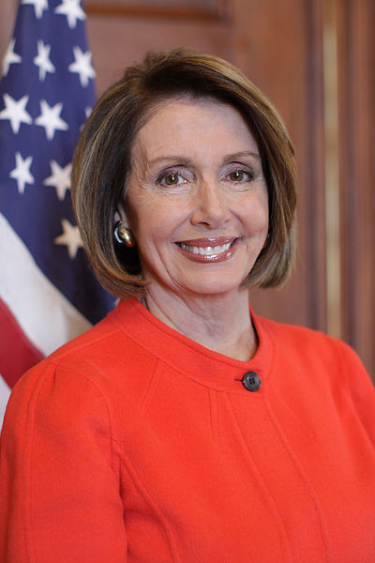
House Majority & Minority Leaders
Political spokesperson of the majority/minority party
Majority Leader assists Speaker of the House in planning legislative program
Minority Leader – Nancy Pelosi (D)
Majority Leader – KEVIN MCCARTHY (R)

Slide 9
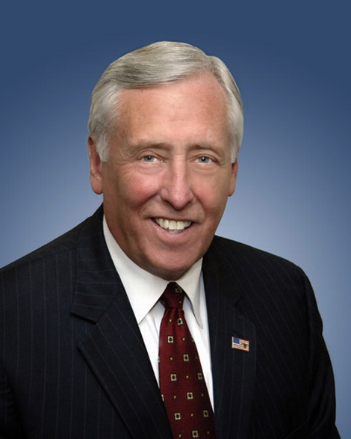
House Majority & Minority Whips
Assistant to the Majority/Minority Leaders
Enforcer who “Whips” their party members into shape
Ensures representatives are present to debate/vote and that they vote with their party
Minority Whip – Steny Hoyer (D)
Majority Whip – STEVE SCALISE (R)

